Slide 1
ENSE 471, Milestone 1
CodeBreakers
Team Members:
Ali Rizvi
Evan Geissler
Shayan Khan
6th February, 2019
Notes:
All

Slide 2
CodeBreakers
We are the CodeBreakers and and our group members are:
Ali Rizvi
Evan Geissler
Shayan Khan
Notes:
All

Slide 3
Prep & Review Stage: Engineering Sites Visited
Engineering sites visited
UofR -> Shayan
UofS -> Evan
UVic -> Ali
Notes:
All

Slide 4
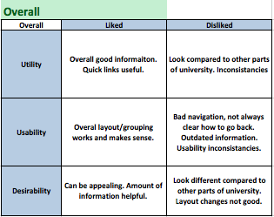
Prep & Review Stage: Overall Sites Visited
Overall ( all customer perspectives)
Did any opportunities arise for innovative ideas?
To a degree, can take the chance to revamp site making it much more user friendly
Notes:
Ali

Slide 5
Prep & Review Stage: Stakeholder Perspectives
Primary users:
Current/future students and their families
Current/future grad students
Collaborators with professors, institutes, researchers, etc.
Want constant look to UofR site
“Our face to the world”
Social Media (external and internal)
Major point is information:
Up to date information, broken links/webpages, more informaiton, etc.
Better information for everyone/for specifics (tuition, programs, etc.)
Notes:
Ali

Slide 6
Target Customers & Observe Stage
Target Customers we are focusing on:
Current Students/Grad Students -> Shayan
Future Students/Grad Students -> Ali
Faculty/Staff -> Evan
Describe each target customer
Discuss at a high-level their needs and desires
Notes:
Each

Slide 7
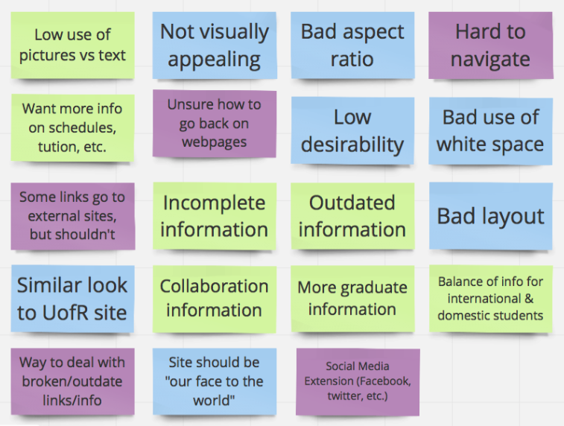
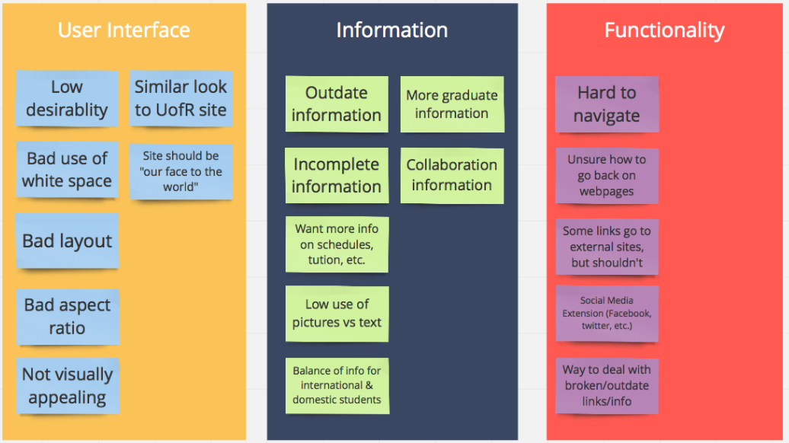
Target Customers & Observe: Affinity Diagram
Notes:
Shayan

Slide 8
Frame stage
Demonstrate your team’s user story map
Emphasize key scenarios (epics, user stories) that you will focus on for your team’s MVPs
Highlight your team’s first MVP
Why were these experiences deemed critical to the first MVP?
Ensure you discuss all target customers
Reminder – Each team member should individually discuss their target customer(s)
Notes:
Evan

Slide 9
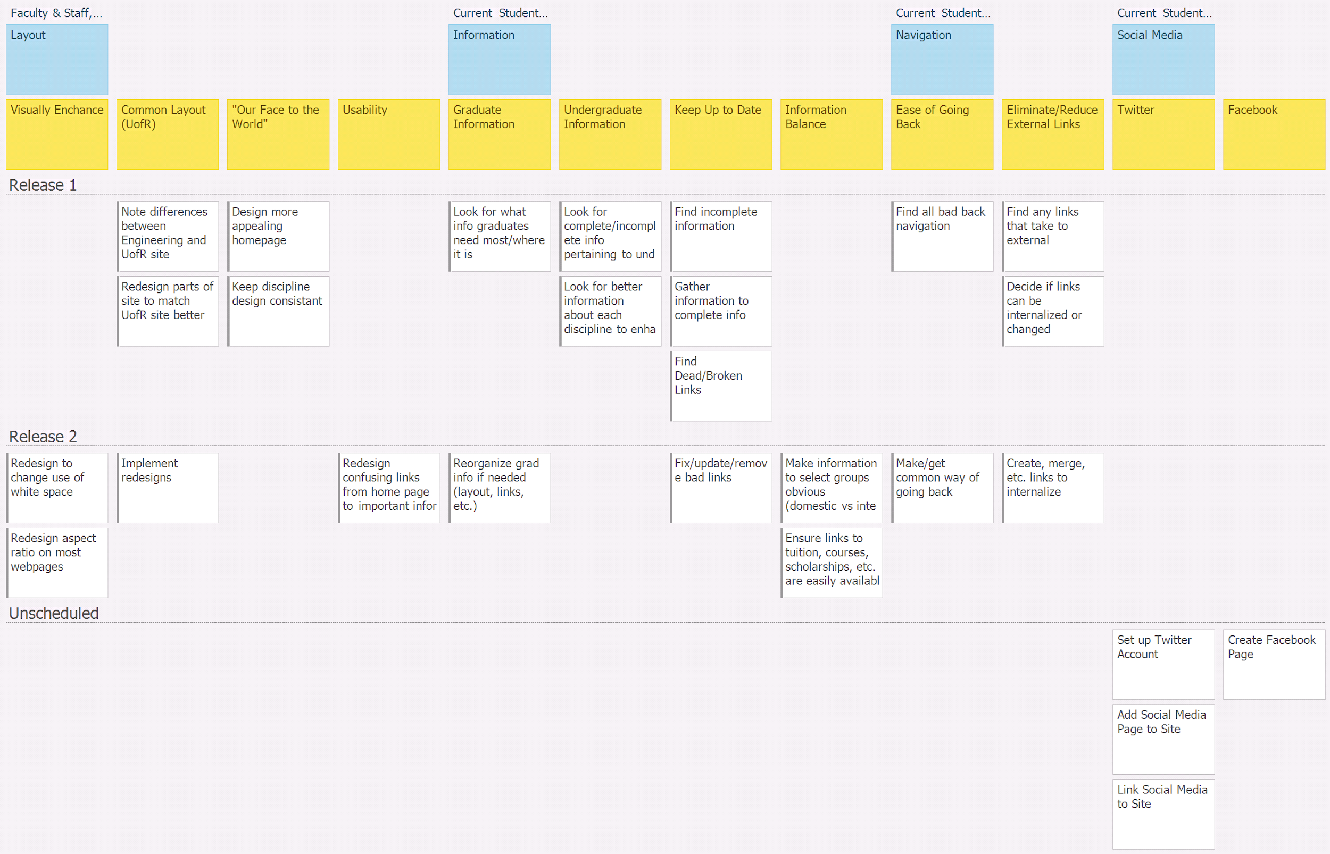
Notes:
Evan

Slide 10
GitHub review
Show your Team’s GitHub: https://github.com/EvanGeissler/ENSE-471-UI-Project-CodeBreakers
Discuss structure and flow
Illustrate Milestone 1 files are uploaded, e.g.
Prep and review documentation
Observe documentation (affinity diagram, etc.)
Frame documentation (USM snapshot, etc.)
Does your team provide the “stamp of approval” for uploaded content and GitHub structure usability/readability (discoverability and understandability)?
Notes:
Evan

Slide 11
Misc.
Peer reviews better when the milestone is due
Would like to have also had a grad student give perspective
Notes:
Shayan

Slide 12
Group Reflection
How did you feel about this milestone? What did you like about it? What did you dislike?
Overall good, got a good feel for what needs to be done
Liked having faculty & Trevor talking about the site
Liked comparing to other universities
Some confusion (Affinity diagram, story maps)
What did you learn about yourself as you collaborated and worked through this milestone?
Our ideas are different as students than others (like faculty)
Working with actual users benefits our understanding more
Notes:
Shayan

Slide 13
Group Reflection
How will you use what you have learned going forward?
Take other’s ideas into account (though can’t please everyone)
Can focus on a wider range of users while still being focused on specifics
What “stuff & things” related to this milestone would you want help with?
Currently nothing going forward
Notes:
Shayan

